Slide 1
Support Vector Machine Algorithm
Support Vector Machine or SVM is one of the most popular Supervised Learning algorithms.
It is used for Classification as well as Regression problems.
However, primarily, it is used for Classification problems in Machine Learning.
The goal of the SVM algorithm is to create the best line or decision boundary that can segregate n-dimensional space into classes so that we can easily put the new data point in the correct category in the future.
This best decision boundary is called a hyperplane.
SVM chooses the extreme points/vectors that help in creating the hyperplane.
These extreme cases are called as support vectors.

Slide 2
In the SVM algorithm, we plot each data item as a point in n-dimensional space (where n is a number of features you have) with the value of each feature being the value of a particular coordinate.
Then, we perform classification by finding the hyper-plane that differentiates the two classes very well.
Hyperplane whose distance from it to the nearest data point on each side is maximized.
If such a hyperplane exists it is known as the maximum-margin hyperplane/hard margin.
SVM algorithm can be used for Face detection, image classification, text categorization, etc.

Slide 3

Consider the below diagram in which there are two different categories that are classified using a decision boundary or hyperplane:

Slide 4
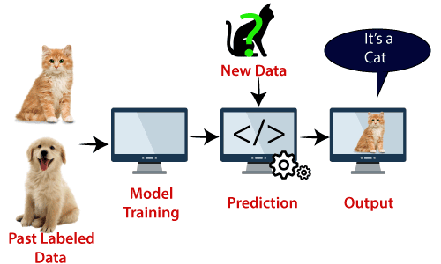
Example: SVM can be understood with the example that we have used in the KNN classifier. Suppose we see a strange cat that also has some features of dogs, so if we want a model that can accurately identify whether it is a cat or dog, so such a model can be created by using the SVM algorithm.
We will first train our model with lots of images of cats and dogs so that it can learn about different features of cats and dogs, and then we test it with this strange creature. So as support vector creates a decision boundary between these two data (cat and dog) and choose extreme cases (support vectors), it will see the extreme case of cat and dog.
On the basis of the support vectors, it will classify it as a cat.
Consider the below diagram:

Slide 5
Types of SVM
Linear SVM: Linear SVM is used for linearly separable data, which means if a dataset can be classified into two classes by using a single straight line, then such data is termed as linearly separable data, and classifier is used called as Linear SVM classifier.
Non-linear SVM: Non-Linear SVM is used for non-linearly separated data, which means if a dataset cannot be classified by using a straight line, then such data is termed as non-linear data and classifier used is called as Non-linear SVM classifier.

Slide 6
Hyperplane: There can be multiple lines/decision boundaries to segregate the classes in n-dimensional space, but we need to find out the best decision boundary that helps to classify the data points. This best boundary is known as the hyperplane of SVM.
The dimensions of the hyperplane depend on the features present in the dataset, which means if there are 2 features (as shown in image), then hyperplane will be a straight line. And if there are 3 features, then hyperplane will be a 2-dimension plane.
We always create a hyperplane that has a maximum margin, which means the maximum distance between the data points.

Slide 7
Support Vectors:
The data points or vectors that are the closest to the hyperplane and which affect the position of the hyperplane are termed as Support Vector.
Since these vectors support the hyperplane, hence called a Support vector.

Slide 8
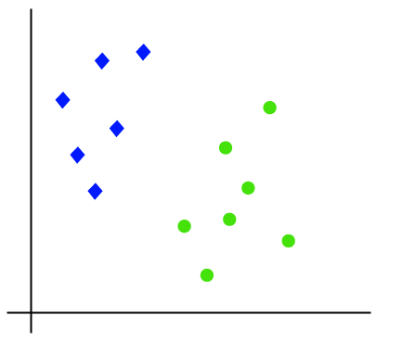
How does SVM works?
Linear SVM: Suppose we have a dataset that has two tags (green and blue), and the dataset has two features x1 and x2. We want a classifier that can classify the pair(x1, x2) of coordinates in either green or blue. Consider the below image:
So as it is 2-d space so by just using a straight line, we can easily separate these two classes.

Slide 9
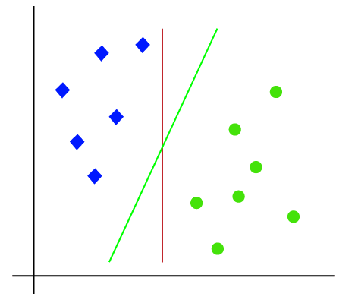
But there can be multiple lines that can separate these classes. Consider the below image:

Slide 10
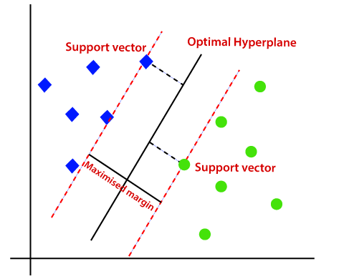
Hence, the SVM algorithm helps to find the best line or decision boundary.
This best boundary or region is called as a hyperplane.
SVM algorithm finds the closest point of the lines from both the classes.
The distance between the vectors and the hyperplane is called as margin.
The hyperplane with maximum margin is called the optimal hyperplane.

Slide 11
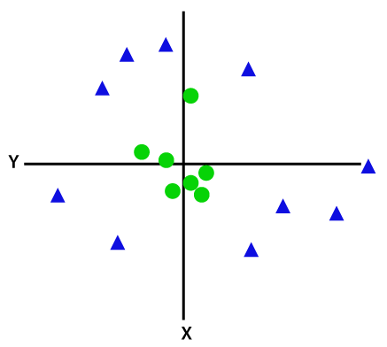
Non-Linear SVM: If data is linearly arranged, then we can separate it by using a straight line, but for non-linear data, we cannot draw a single straight line.
Consider the below image:

Slide 12
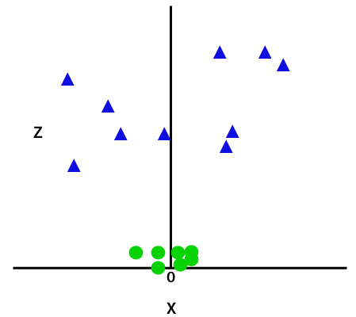
So to separate these data points, we need to add one more dimension. For linear data, we have used two dimensions x and y.
So for non-linear data, we will add a third dimension z. It can be calculated as:
z=x² +y²
By adding the third dimension, the sample space will become as below image:

Slide 13
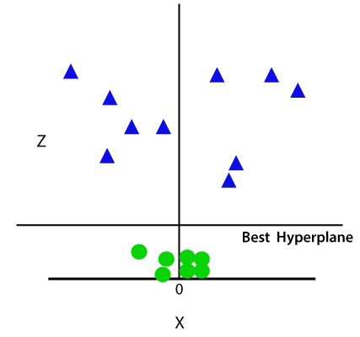

Slide 14
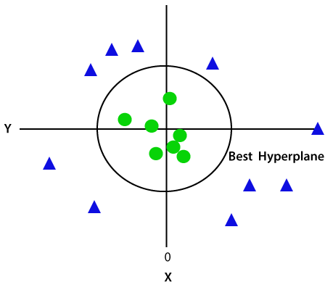
Since we are in 3-d Space, hence it is looking like a plane parallel to the x-axis. If we convert it in 2d space with z=1, then it will become as:

Slide 15
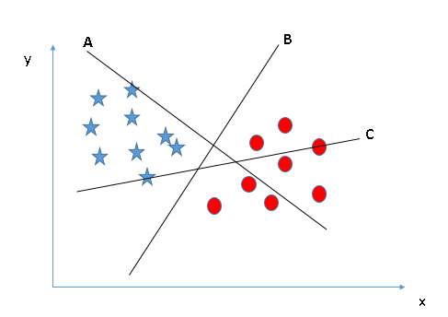
How can we identify the right hyper-plane?”. Don’t worry, it’s not as hard as you think!
Scenario-1:Identify the right hyper-plane: Here, we have three hyper-planes (A, B, and C). Now, identify the right hyper-plane to classify stars and circles.
To identify the right hyper-plane: “Select the hyper-plane which segregates the two classes better”.
In this scenario, hyper-plane “B” has excellently performed this job.

Slide 16
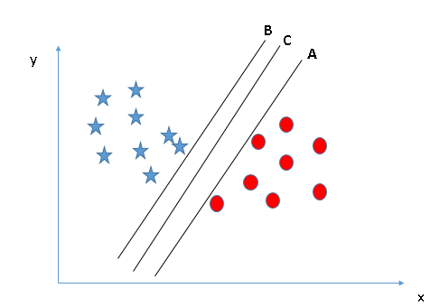
Scenario-2: Identify the right hyper-plane : Here, we have three hyper-planes (A, B, and C) and all are segregating the classes well. Now, How can we identify the right hyper-plane?
Here, maximizing the distances between nearest data point (either class) and hyper-plane will help us to decide the right hyper-plane. This distance is called as Margin.

Slide 17
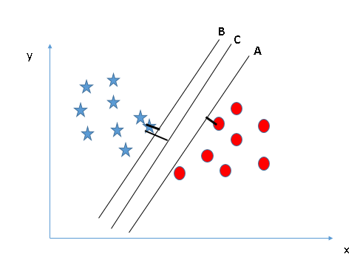
Let’s look at the below snapshot:
Above, you can see that the margin for hyper-plane C is high as compared to both A and B. Hence, we name the right hyper-plane as C. Another lightning reason for selecting the hyper-plane with higher margin is robustness. If we select a hyper-plane having low margin then there is high chance of miss-classification.

Slide 18
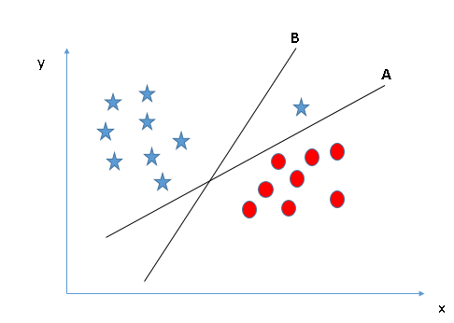
Scenario3:Identify the right hyper-plane :
Some of you may have selected the hyper-plane B as it has higher margin compared to A. But, here is the catch, SVM selects the hyper-plane which classifies the classes accurately prior to maximizing margin. Here, hyper-plane B has a classification error and A has classified all correctly. Therefore, the right hyper-plane is A.

Slide 19
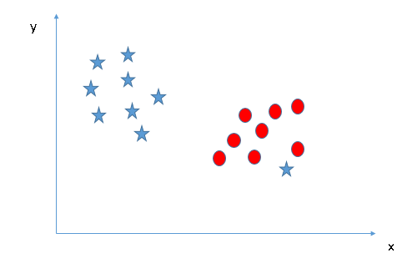
Scenario-4:-Can we classify following two classes ?
Below, I am unable to segregate the two classes using a straight line, as one of the stars lies in the territory of other(circle) class as an outlier.

Slide 20
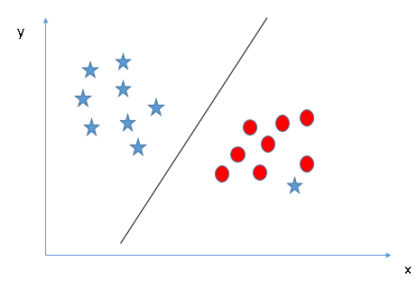
As I have already mentioned, one star at other end is like an outlier for star class.
The SVM algorithm has a feature to ignore outliers and find the hyper-plane that has the maximum margin.
Hence, we can say, SVM classification is robust to outliers.

Slide 21
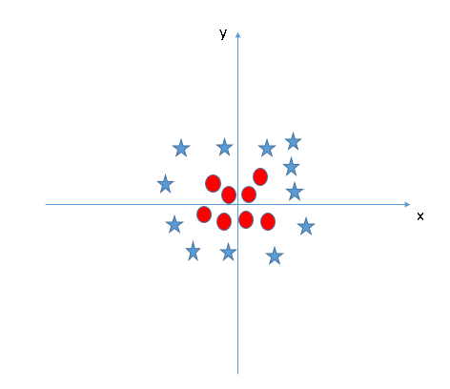
(Scenario-5): Find the hyper-plane to segregate to classes
In the Fig. given below, we can’t have linear hyper-plane between the two classes, so how does SVM classify these two classes?
Till now, we have only looked at the linear hyper-plane.

Slide 22
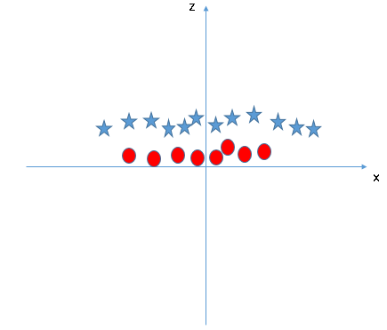
SVM can solve this problem. Easily! It solves this problem by introducing additional feature. Here, we will add a new feature z=x^2+y^2. Now, let’s plot the data points on axis x and z:
In above plot, points to consider are:
All values for z would be positive always because z is the squared sum of both x and y
In the original plot, red circles appear close to the origin of x and y axis, leading to lower value of z and star relatively away from the origin result to higher value of z.

Slide 23
In the SVM classifier, it is easy to have a linear hyper-plane between these two classes.
But, another burning question arises is, should we need to add this feature manually to have a hyper-plane.
No, the SVM algorithm has a technique called the kernel trick.

Slide 24
SVM Kernel:
The SVM kernel is a function that takes low dimensional input space and transforms it to a higher dimensional space.
i.e. it converts not separable problem to separable problem. (2-dimension space to 3-dimension space)
It is mostly useful in non-linear separation problem.
Simply put, it does extremely complex data transformations, and
then finds out the process to separate the data based on the labels or Category.

Slide 25
What is SVM Kernel Functions?
Kernels or kernel methods (also called Kernel functions) are sets of different types of algorithms that are being used for classification.
They are used to solve a non-linear classification problem by using a linear classifier.
The SVM uses what is called a “Kernel Trick” where the data is transformed and an optimal boundary is found for the possible outputs.
The kernel functions job is to take data as input and transform it in any required form.
In this article, we will be looking at various types of kernels.

Slide 26
What is Kernel?
A kernel is a function used in SVM for helping to solve problems.
They provide shortcuts to avoid complex calculations.
The amazing thing about kernel is that we can go to higher dimensions and perform smooth calculations with the help of it.
A kernel helps to form the hyperplane in the higher dimension without raising the complexity.

Slide 27
It is very difficult to solve this classification using a linear classifier as there is no good linear line that should be able to classify the red and the green dots as the points are randomly distributed.
Here comes the use of kernel function which transform the points to higher dimensions, solves the problem over there and returns the output.
Think of this in this way, we can see that the square are enclosed in some perimeter area while the circle lies outside it, likewise, there could be other scenarios where green dots might be distributed in a trapezoid-shaped area.
So, what we do is to convert the two-dimensional plane which was first classified by one-dimensional hyperplane (“or a straight line”) to the three-dimensional area and here our classifier i.e. hyperplane will not be a straight line but a two-dimensional plane which will cut the area.

Slide 28
Kernels are the function to solve non-linear problems with the help of linear classifiers.
The kernel functions are used as parameters in the SVM codes.
They help to determine the shape of the hyperplane and decision boundary.
We can set the value of the kernel parameter in the SVM code.
The value can be any type of kernel from linear to polynomial.
If the value of the kernel is linear then the decision boundary would be linear and two-dimensional.
We do not need to do complex calculations.
The kernel functions do all the hard work.
We just have to give the input and use the appropriate kernel.

Slide 29
SVM algorithms use a set of mathematical functions that are defined as the kernel.
Different SVM algorithms use different types of kernel functions.
These functions can be of different types. For example
Linear,
Nonlinear,
Polynomial
Radial basis function (RBF), and
Sigmoid.
The mostly used kernel function is RBF. Because it has localized and finite response along the entire x-axis.
The kernel functions return the inner product between two points in a suitable feature space.
Simply put, it does some extremely complex data transformations, then finds out the method to separate the data points based on the target classes you’ve defined.

Slide 30
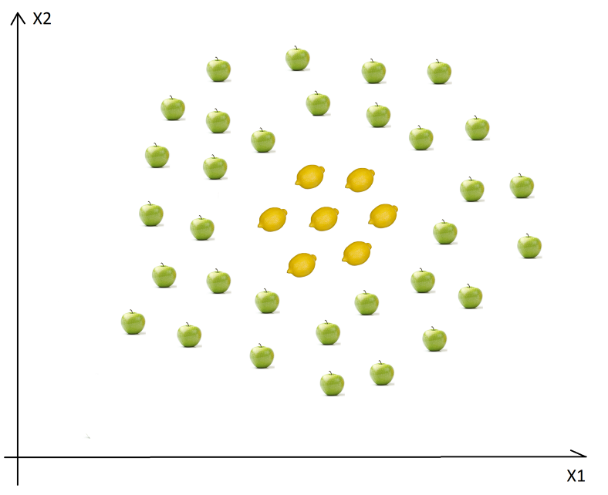
SVM for Non-Linear Data Sets
An example of non-linear data is:
In this case we cannot find a straight line to separate apples from lemons.
So how can we solve this problem. We will use the Kernel Trick!

Slide 31
The basic idea is that when a data set is inseparable in the current dimensions, add another dimension, may be that way the data will be separable.
Just think about it, the example above is in 2D and it is inseparable, but may be in 3D there is a gap between the apples and the lemons, may be there is a level difference, so lemons are on level one and apples are on level two.
In this case, we can easily draw a separating hyperplane (in 3D a hyperplane is a plane) between level-1 and 2.
Mapping to Higher Dimensions:
To solve this problem we shouldn’t just blindly add another dimension, we should transform the space so we generate this level difference intentionally.
Mapping from 2D to 3D

Slide 32
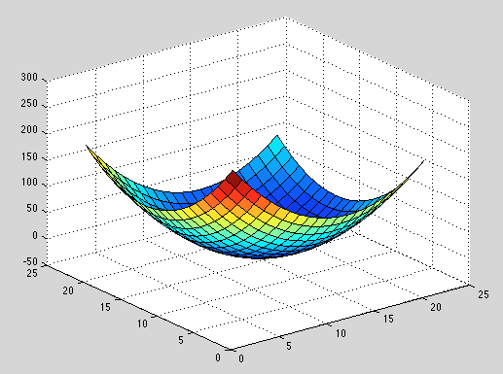
Mapping from 2D to 3D:
Let's assume that we add another dimension called X3. Another important transformation is that in the new dimension the points are organized using the formula x3=x1² + x2².
If we plot the plane defined by the x1² + x2² formula, we will get something like this:
.

Slide 33
Now we have to map the apples and lemons (which are just simple points) to this new space.
Think about it carefully, what did we do?
We just used a transformation in which we added levels based on distance.
If you are in the origin, then the points will be on the lowest level.
As we move away from the origin, it means that we are climbing the hill (moving from the center of the plane towards the margins), so the level of the points will be higher.

Slide 34
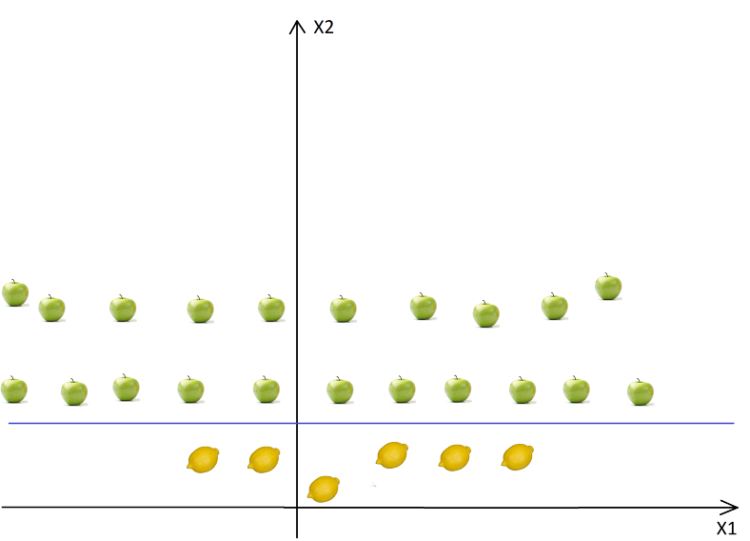
Now if we consider that the origin is the lemon from the center, we will have something like this:
Now we can easily separate these two classes.
These transformations are called kernels.
Popular kernels are: Linear Kernel, Non-Linear Kernel, Polynomial Kernel, Gaussian Kernel, Radial Basis Function (RBF), Laplace RBF Kernel, Sigmoid Kernel, etc.

Slide 35
Types of Kernel and methods in SVM
1. Linear Kernel: Let us say that we have two vectors with name x1 and x2, then the linear kernel is defined by the dot product of these two vectors:
Linear Kernel Formula
F(xi, xj) = sum( xi.xj)
Here, xi, xj represents the data you’re trying to classify.
2. Polynomial Kernel: A polynomial kernel is defined by the following equation:
K(x1, x2) = (x1. x2 + 1)^{d},
Where, d is the degree of the polynomial and x1 and x2 are vectors/data point.
Polynomial Kernel Formula
F(xi, xj) = (xi.xj+1)^d
Here ‘.’ shows the dot product of both the values, and d denotes the degree.
F(xi, xj) representing the decision boundary to separate the given classes.

Slide 36

3. Gaussian RBF Kernel: It is a general-purpose kernel; used when there is no prior knowledge about the data.
Equation is:
This kernel is an example of a radial basis function kernel.
Below is the equation for this:
for
F(x, xj) = exp(-gamma * ||x - xj||^2)
The value of gamma varies from 0 to 1. You have to manually provide the value of gamma in the code. The most preferred value for gamma is 0.1.
The given sigma plays a very important role in the performance of the Gaussian kernel and should neither be overestimated and nor be underestimated, it should be carefully tuned according to the problem.
It is one of the most preferred and used kernel functions in svm. It is usually chosen for non-linear data. It helps to make proper separation when there is no prior knowledge of data.

Slide 37
4. Hyperbolic or the Sigmoid Kernel
This kernel is used in neural network areas of machine learning.
The activation function for the sigmoid kernel is the bipolar sigmoid function.
The equation for the hyperbolic kernel function is:
This kernel function is similar to a two-layer perceptron model of the neural network, which works as an activation function for neurons.
It can be shown as,
Sigmoid Kernel Function
F(x, xj) = tanh(αx^{T}y + c)

Slide 38
Advantages of SVM Kernel Function:
Effective in high dimensional cases.
Its memory efficient as it uses a subset of training points in the decision function called support vectors.
Different kernel functions can be specified for the decision functions and its possible to specify custom kernels.

